Slide 1


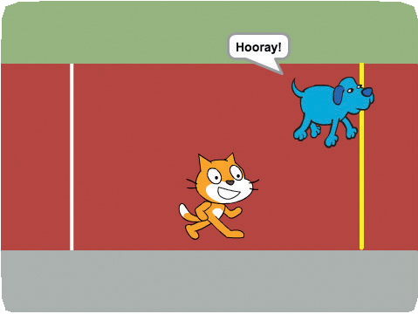
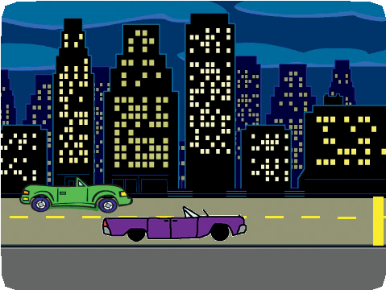
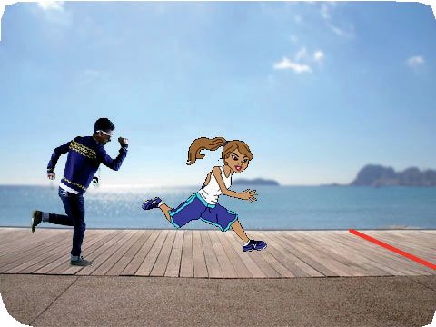
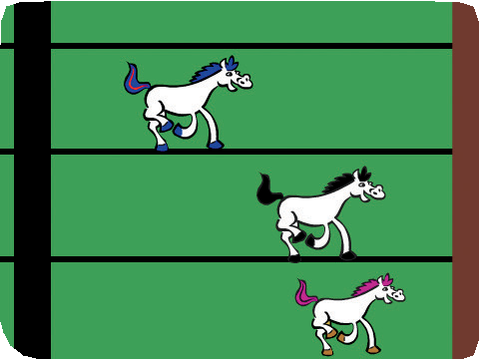

Race to the Finish Cards
Race to the Finish
Make a game where two characters race each other.
scratch.mit.edu/racegame

Slide 2
Race to the Finish Cards
Race to the Finish
Use these cards in this order:
Start the Race
On Your Mark
Reach the Finish Line
Choose a Racer
Add a Sound
Animate the Run
Race the Computer
scratch.mit.edu/racegame

Slide 3
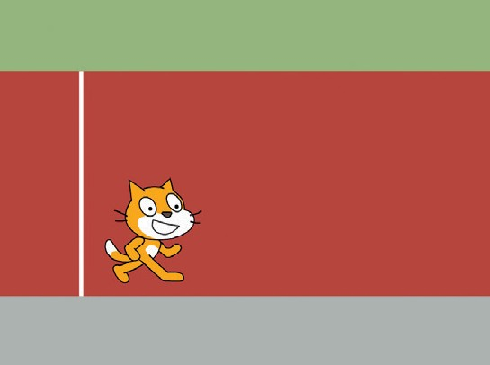
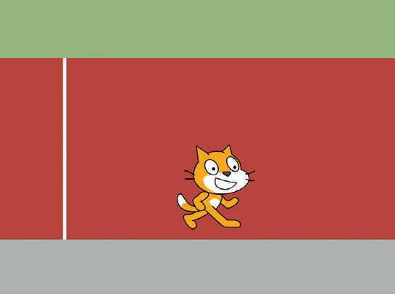
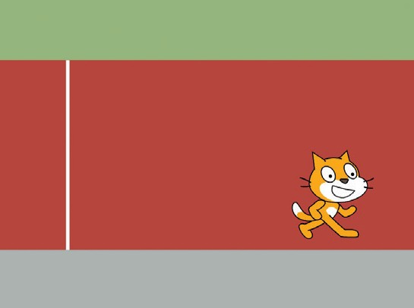
Start the Race
Make your sprite move on a racetrack.
Race to the Finish
1

Slide 4


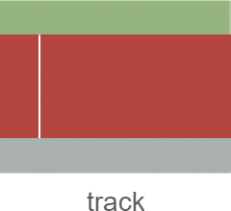
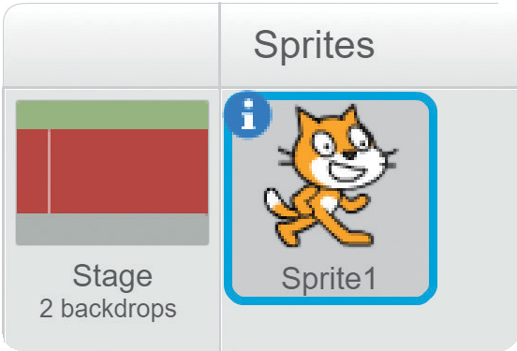

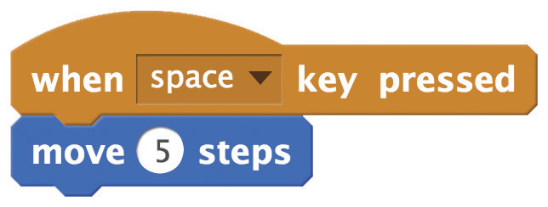
Start the Race
scratch.mit.edu/racegame
GET READY
Choose a backdrop.
Click to select the cat.
ADD THIS CODE
Click the tab.
Try different numbers
to change the speed.
TRY IT
Press the space key to move the sprite.

Slide 5
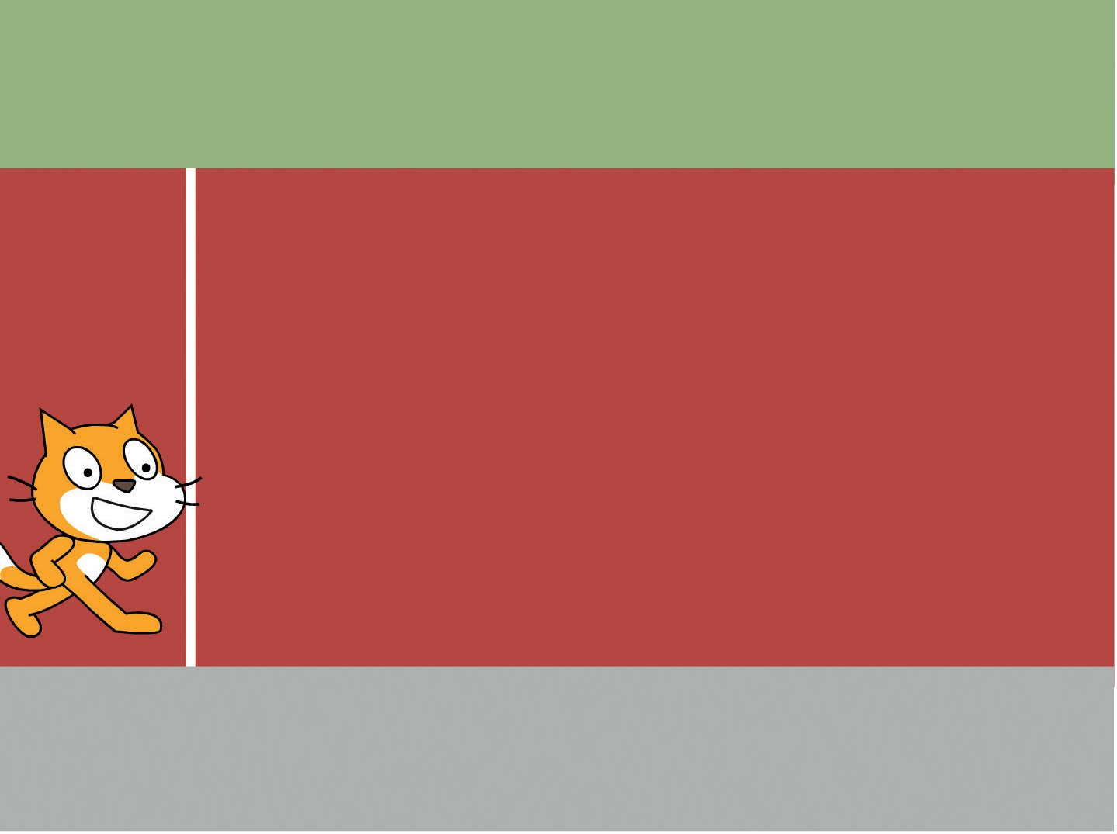
On Your Mark
Choose a starting point for your sprite.
Race to the Finish
2

Slide 6

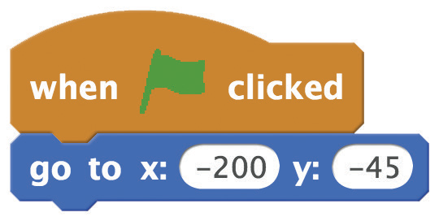


On Your Mark
scratch.mit.edu/racegame
GET READY
Drag your sprite to where you want it on the Stage.
ADD THIS CODE
Set the starting position. (Your numbers may be different.)
TRY IT
Press the space key to move your sprite.
Click the green
flag to reset.

Slide 7
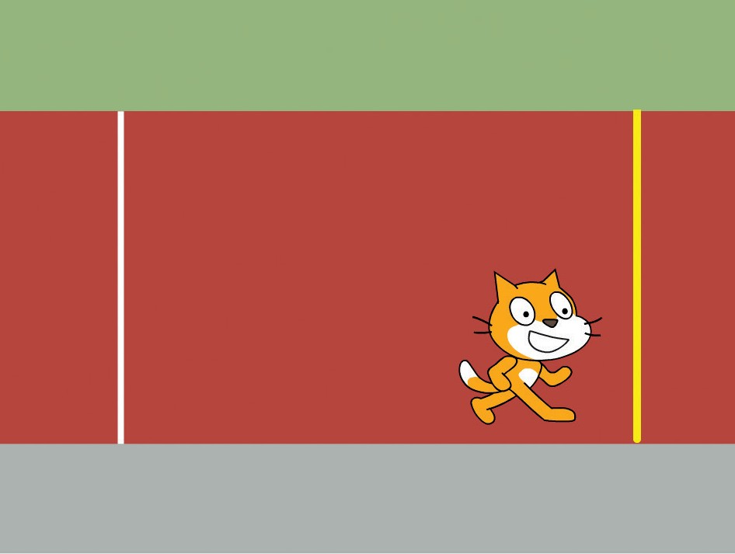
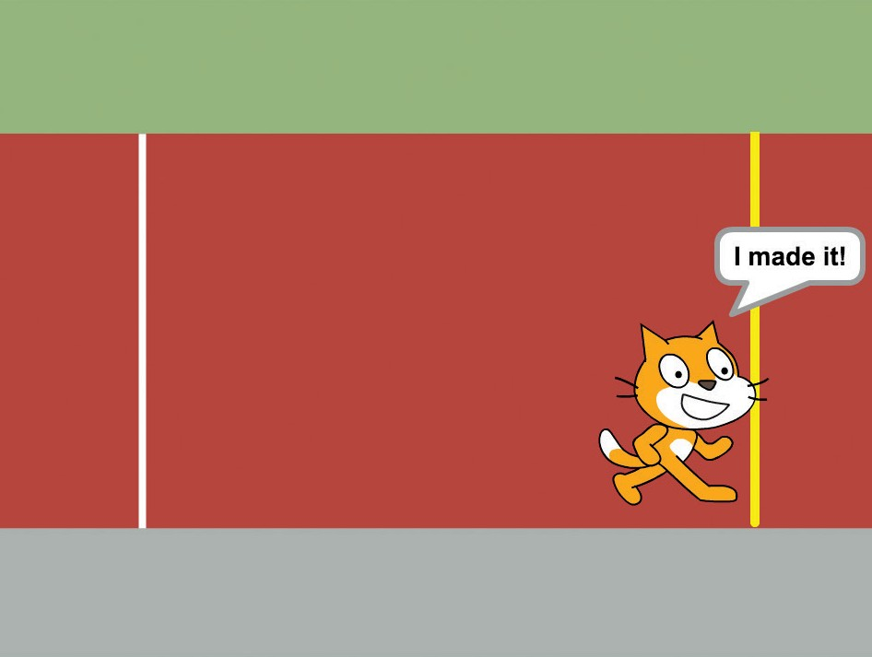
Reach the Finish Line
Make your sprite do something when it reaches the finish line.
Race to the Finish
3

Slide 8
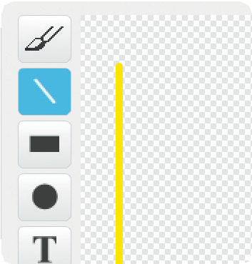

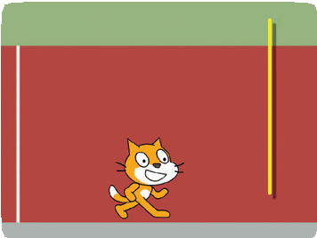
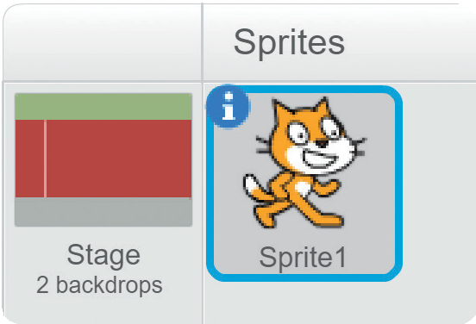
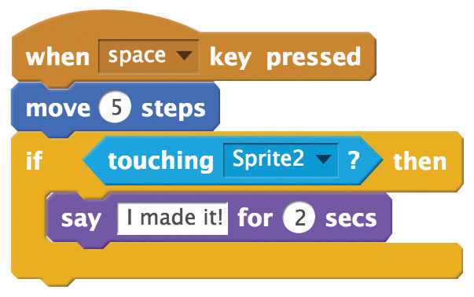

Reach the Finish Line
scratch.mit.edu/racegame
GET READY
Click the paintbrush to draw a new sprite.
Choose the Line tool and draw a line.
To make a straight line, hold down the Shift key while drawing.
Drag the line (Sprite2) to where you want it on the Stage.
ADD THIS CODE
Click the tab.
Click to select the cat.
Choose Sprite2.
Add these blocks.
TRY IT
Click the green
flag to start.
Keep pressing the space key
until you cross the finish line!

Slide 9
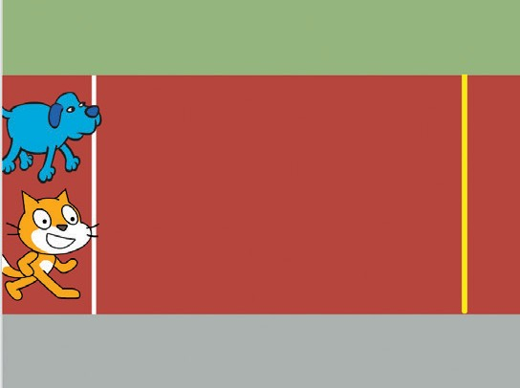
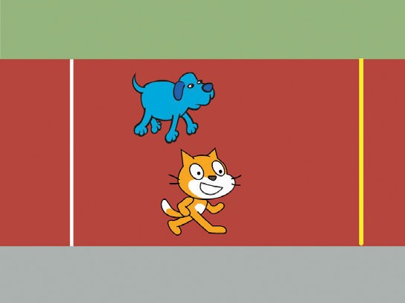
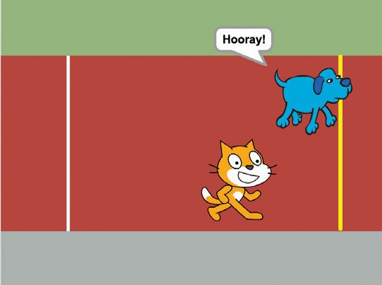
Choose a Racer
Add another sprite so you can have a race.
Race to the Finish
4

Slide 10
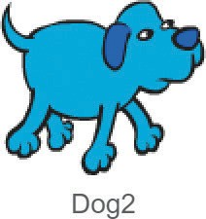

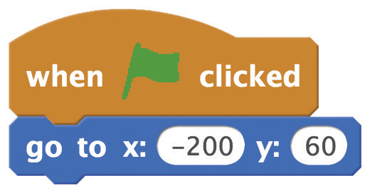
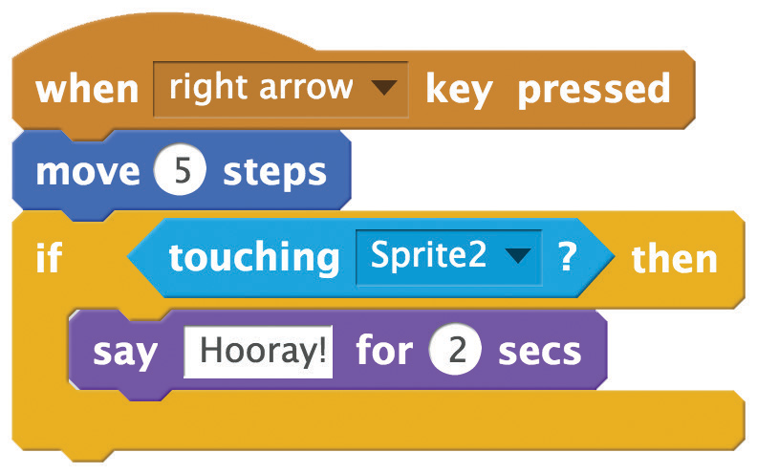

Choose a Racer
scratch.mit.edu/racegame
GET READY
Choose a sprite to be the second racer.
ADD THIS CODE
Drag your sprite to where you want it to start.
Choose right arrow
or a different key.
TRY IT
Click the green
flag to start.
Press the space key and the right arrow key to make your sprites race.

Slide 11
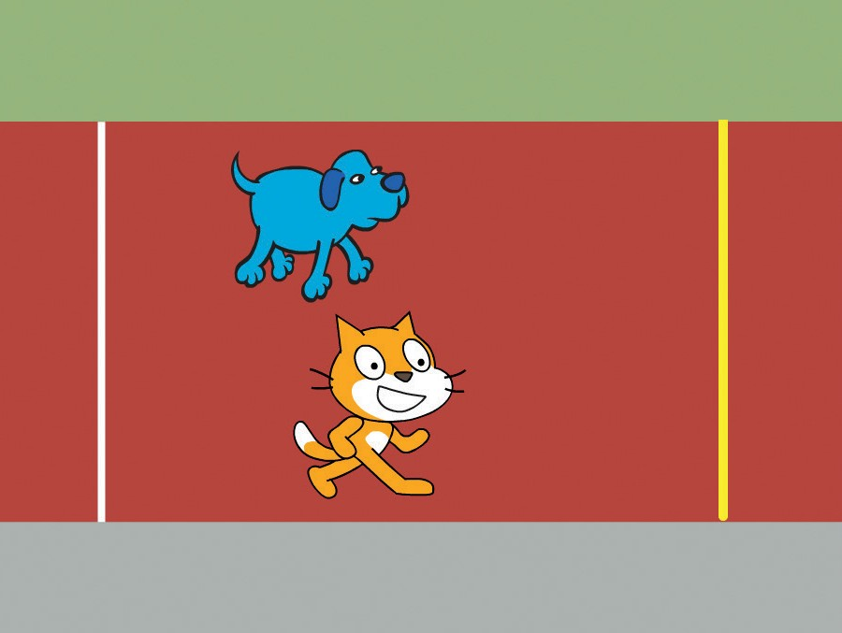
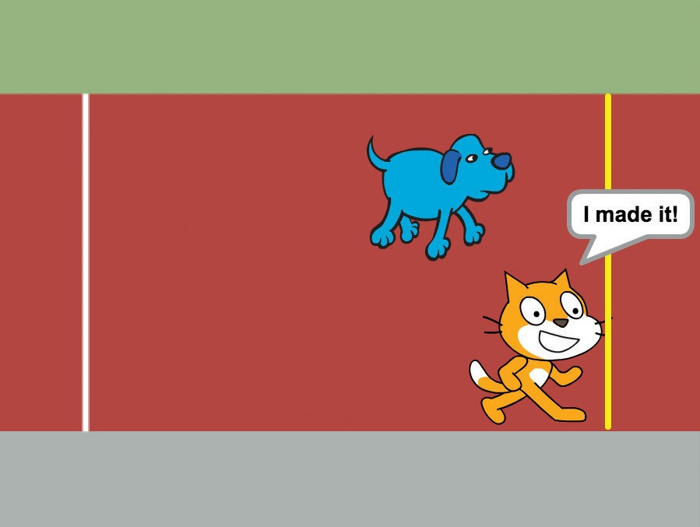
Add a Sound
Play a sound when you win the race.
Race to the Finish
5

Slide 12

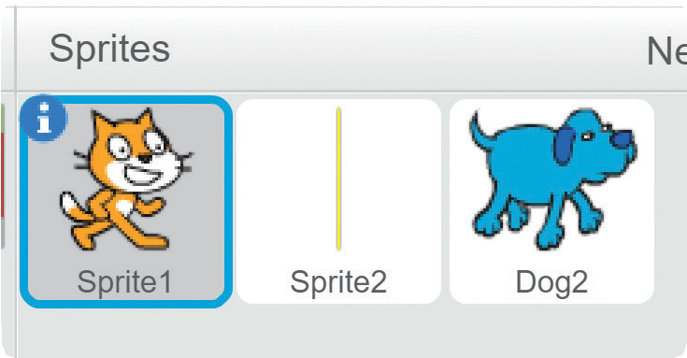

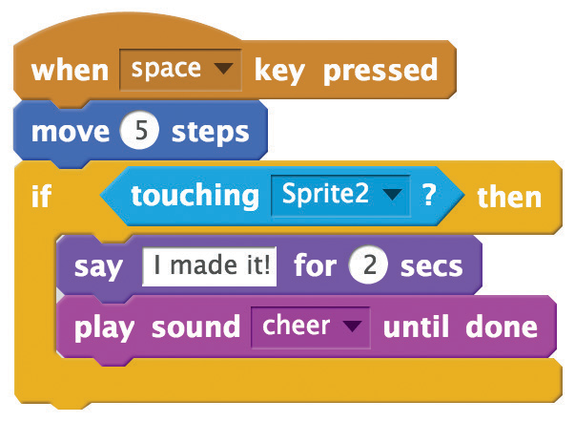

Add a Sound
scratch.mit.edu/racegame
GET READY
Click to select the cat.
Click the
tab.
Then choose a sound from the Sound library, like cheer.
ADD THIS CODE
Click the tab.
Add this block
to play the sound.
TRY IT
Click the green
flag to start.
Press the space key until
you cross the finish line!

Slide 13
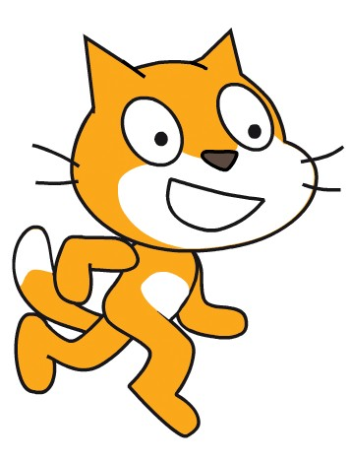
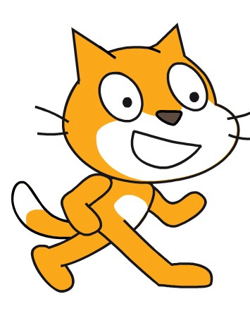
Animate the Run
Switch costumes to make your sprite look like it’s running.
Race to the Finish
6

Slide 14

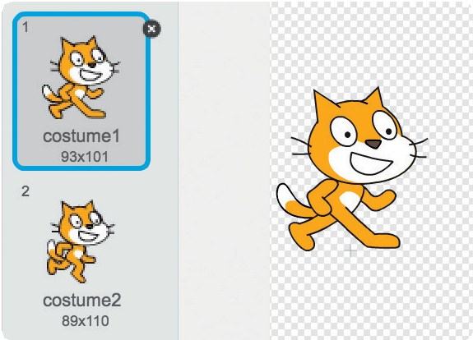
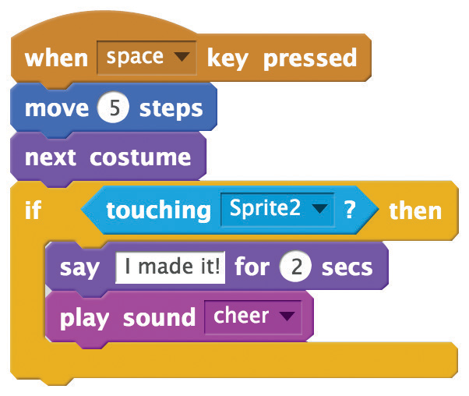
Animate the Run
scratch.mit.edu/racegame
GET READY
tab to see your sprite’s costumes.
Click the
ADD THIS CODE
Click the tab.
Add this block to switch between costumes.
TRY IT
Press the space key.
TIP
You can animate any sprite that has more than one costume.

Slide 15
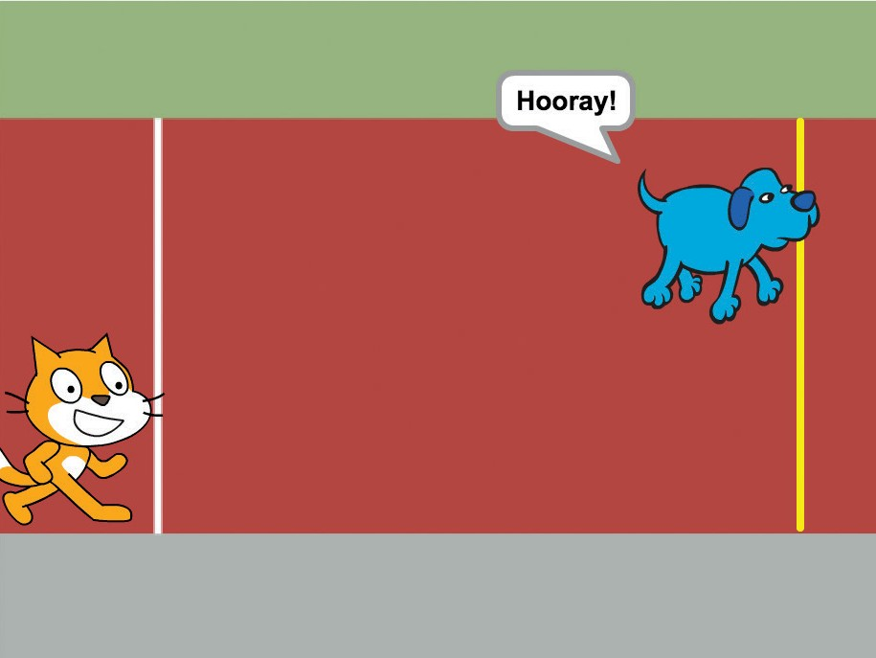
Race the Computer
Race against a sprite that moves automatically.
Race to the Finish
7

Slide 16
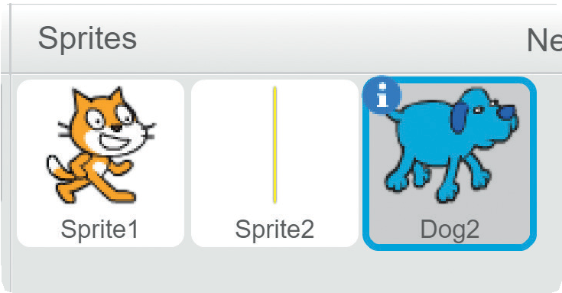
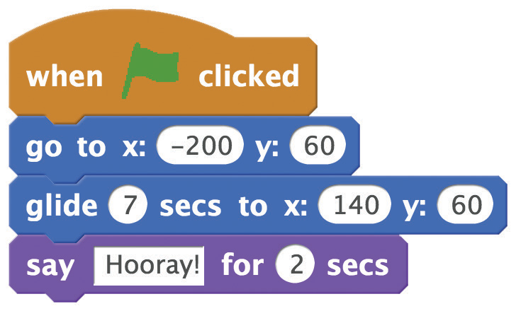

Race the Computer
scratch.mit.edu/racegame
GET READY
Choose the sprite you want to move automatically.
ADD THIS CODE
Type a smaller number of seconds
to go faster.
TRY IT
Click the green
flag to start.
Press the space key to move the other sprite.

